Slide 1

RFID BASED SMART ATTENDENCE SYSTEM
B.Tech (ECE) Project Presentation
Presented by:
SHASHIKANT DWIVEDI (2025041245)
SUBHASH SINGH (2025041251)
NIKHIL KUMAR (2025041261)
SARANG GOPALAN (2025041265)
SATYAM PRAJAPATI (2025041260)
Department of Electronics and Communication Engineering,
Madan Mohan Malaviya University of Technology, Gorakhpur (UP) , India

Slide 2
Outline of Presentation
Introduction & Motivation
Block Diagram & Circuit
Technologies Used
Uniqueness & Innovation
Impact, Feasibility & Conclusion
References & Q&A

Slide 3
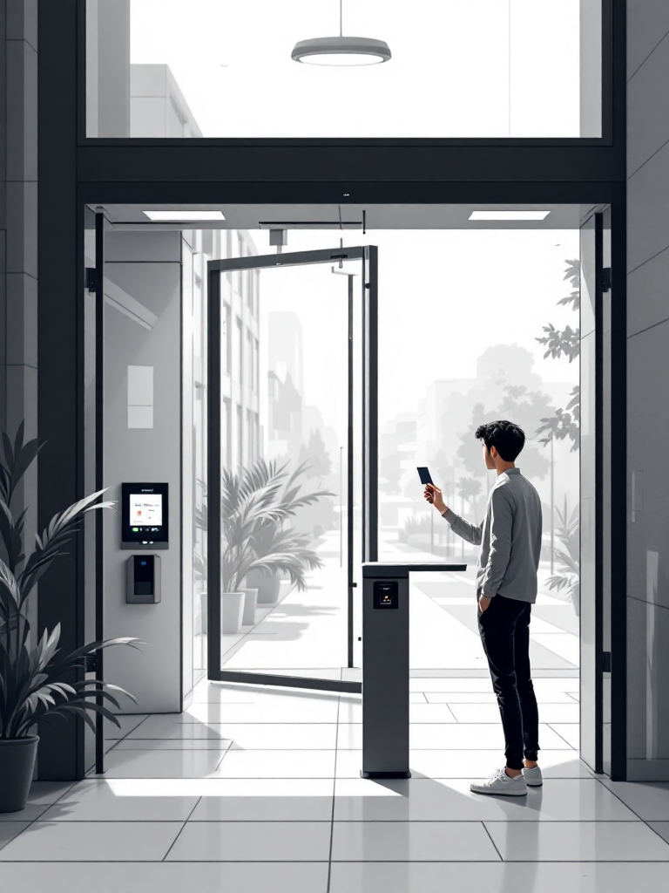
Project Description/Objective/Motivation
The Problem
Traditional roll-call is time-consuming and prone to proxy attendance
Paper registers are error-prone and lack real-time accessibility
No centralised tracking for faculty or administration
Our Objective
Automate attendance using RFID and ESP32 microcontroller
Transmit records wirelessly via WiFi to a cloud database
Display live attendance on a responsive web dashboard
Save time, improve accuracy, and enhance transparency

Slide 4
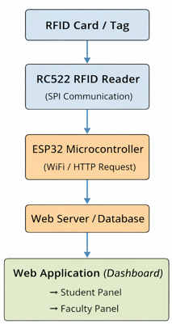
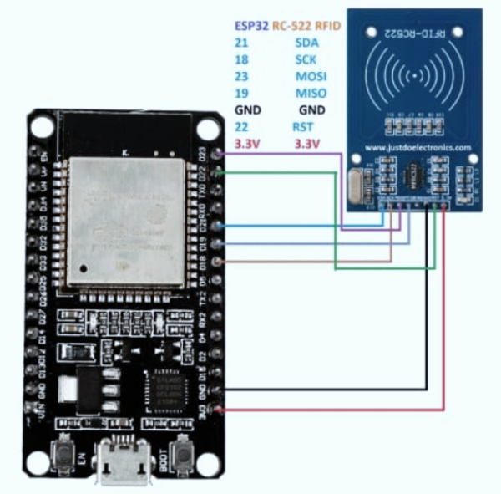
Block Diagram and Circuit Description
• The RC522 RFID module is connected to ESP32 using SPI interface. • Pins used: SDA, SCK, MOSI, MISO, RST, 3.3V, and GND. • ESP32 provides power and controls communication with the RFID module. • When a card is scanned, RC522 sends data to ESP32 for processing.
• The RFID card is scanned using the RC522 reader. • The reader sends the UID to the ESP32 via SPI communication. • ESP32 processes the data and sends it to the server using WiFi. • The server stores the attendance in the database. • The web dashboard displays attendance for students and faculty.

Slide 5
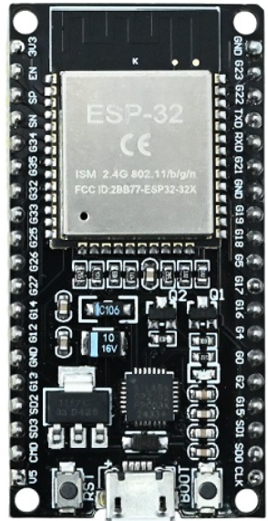
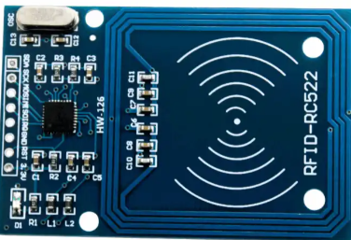



Technology and Components Used
ESP32 Microcontroller
Dual-core MCU with built-in WiFi and Bluetooth; handles UID processing and cloud communication
RFID RC522 Module
13.56 MHz MIFARE reader; communicates with ESP32 via SPI interface at low power
Firebase Realtime DB
Google's NoSQL cloud database; stores attendance records and enables live sync to the dashboard
Web Dashboard
Built with HTML, CSS, and JavaScript; separate panels for students and faculty with live data
WiFi Communication
ESP32 connects to local network; data pushed to Firebase over HTTPS in near real time
Low-Cost BOM
Total hardware cost ~₹800–1,200: ESP32 (₹400), RC522 (₹150), Cards (₹30 each), misc. components

Slide 6
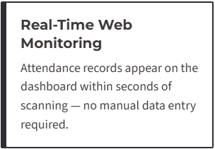
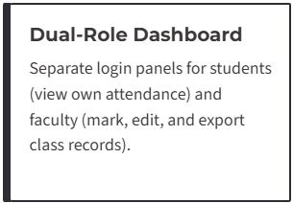
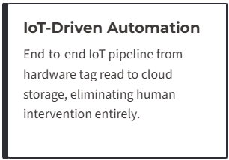
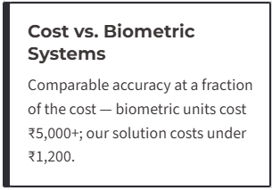
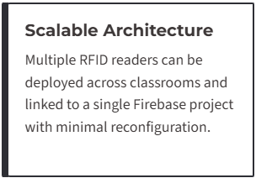
Differentiation/Uniqueness/Innovation of Project

Slide 7
Impact and Feasibility of Product
RFID SYSTEM
TIME SAVING
ACCURACY
REDUCE PROXY
BETTER MANAGEMENT
IMPACT
• Saves time and reduces manual effort • Improves accuracy • Reduces proxy attendance • Real-time tracking • Useful for institutions
FEASIBILITY
• Low-cost implementation • Easy setup and maintenance • Scalable system • Uses existing WiFi • Practical for real use

Slide 8




Conclusion and Future Scope
Automated
Accurate
Time Saving
Real -Time
Efficient Attendence System
Reliable and Scaleble
RFID SYSTEM
MOBILE APP
FACE RECOGNITION
QR ATTENDENCE

Slide 9
Upcoming Plan/Layout
🔷 Role of Team Members
• Hardware Development: ESP32 and RC522 interfacing • Web Development: Dashboard design (Student & Faculty portal) • Backend & Database: Attendance storage and API handling • Testing & Integration: System testing and debugging
🔷 Project Timeline / Approach
• Phase 1: Hardware setup and RFID integration • Phase 2: Web application development • Phase 3: Database connection and real-time data transfer • Phase 4: Testing, debugging, and final deployment
🔷 Progress Achieved Till Now
• Successfully connected ESP32 with RC522 module • RFID card reading and UID detection completed • Web dashboard for attendance tracking developed • Real-time data transfer implemented

Slide 10
References (Sample to write proper references)
Espressif Systems. ESP32 Technical Reference Manual. Espressif Systems, 2023. Available: https://www.espressif.com/en/support/documents/technical-documents
NXP Semiconductors. MFRC522 Standard Performance MIFARE and NTAG Frontend, Rev. 3.9. NXP, 2016. Available: https://www.nxp.com/docs/en/data-sheet/MFRC522.pdf
Google LLC. Firebase Realtime Database Documentation. Google Developers, 2024. Available: https://firebase.google.com/docs/database
K. Ashton, "That 'Internet of Things' Thing," RFID Journal, vol. 22, no. 7, pp. 97–114, 2009.
S. Sharma and A. Gupta, "IoT-Based Attendance Management System Using RFID and Cloud," Int. Journal of Engineering Research & Technology (IJERT), vol. 9, no. 6, 2020.
R. Patel et al., "Design and Implementation of RFID-Based Attendance System with Real-Time Database," Proc. IEEE ICCUBEA, Pune, 2021, pp. 1–5.

Slide 11
THANK YOU

